Slide 1
DLPC900 User Guide Summary
Jason Zhu
11-2023

Slide 2
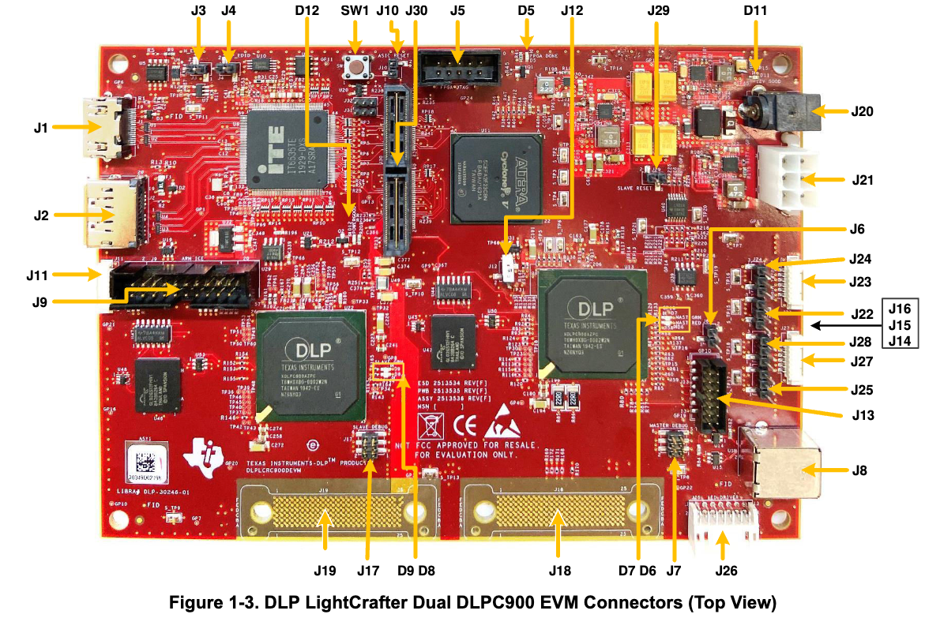
DLPC900 Motherboard

Slide 3
J8 – host USB input
J20 - 12V DC power input
J18, J19 – DMD connector
J1 – HDMI Input(Video input to Video Splitter FPGA and DLPC900 controllers. For Video or Video Pattern inputs (primary)?)
D5 – FPGA init done
D7 – Green Heartbeat LED (When toggling indicates Primary DLPC900 controller is operating)
D11 – 12V power LED

Slide 4
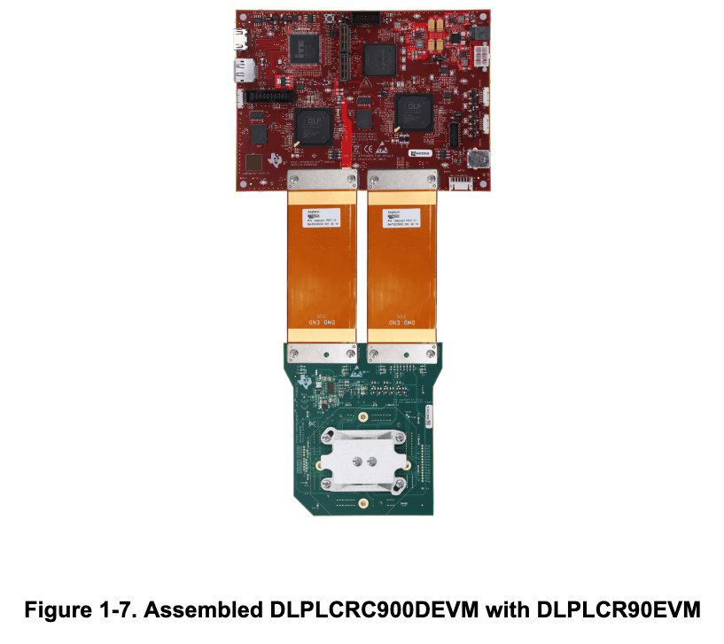
After Being Assembled

Slide 5
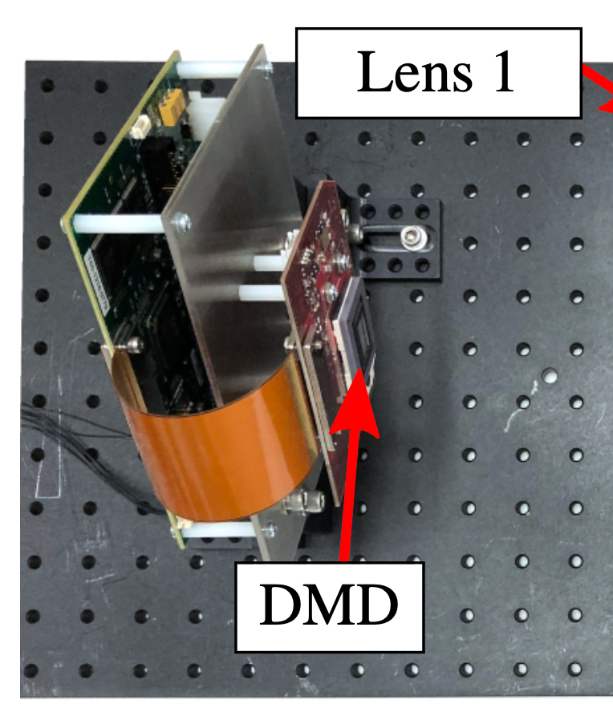
Fixation on Board

Slide 6
Incoming Angle of Laser
Didn’t find exact angle info inside manual
Searched both online and on paper – should be 24 degrees

Slide 7
Quick Start
Connect a 12-V DC power supply to the power supply connector J20.
LEDs — D5, D11, and D12 light up green to indicate configuration and power is normal.
LEDs — D7 and D9 toggle on and off, indicating the DLPC900 controllers are operating normally.
After 5 seconds, the two DLPC900 devices start sending a built-in rotating pattern sequence of images to the DMD for display on the DMD.
Connect a USB cable from a PC to connector J8 on the DLP LightCrafter Dual DLPC900 EVM. The first time the cable is connected on a PC, the DLP LightCrafter Dual DLPC900 EVM enumerates as a USB composite device with human-interface device (HID) class. No drivers are required since these are natively handled by all operating systems.
The DLP LightCrafter Dual DLPC900 EVM can be controlled with the free GUI software and firmware versions available for download from DLPLCRC900DEVM

Slide 8
Intro Videos for Software
Getting started: TI DLP® LightCrafter™ 6500 and 9000 EVMs
Getting started: TI DLP® LightCrafter™ 6500 & 9000 EVMs Pt 2

